Slide 1

SQL Murder Mystery
Who Killed the CEO? – A SQL Investigation
By Sonali Gupta

Slide 2
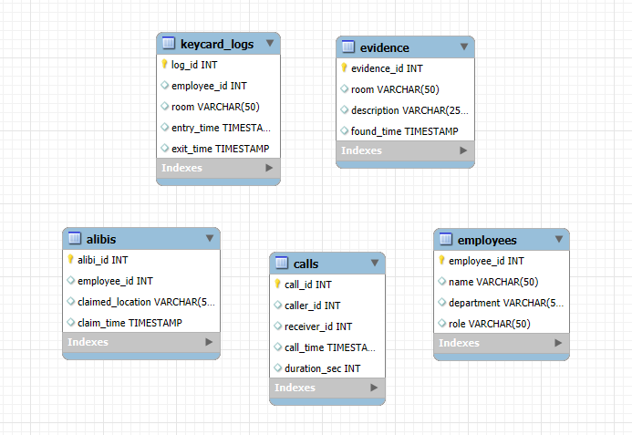





Case Brief
Evidence Sources
We investigate using:
CEO of TechNova Inc. found dead
Date: 15 Oct 2025
🔑 Keycard Logs (entries & exits)
Time: Around 9:00 PM
📞 Call Records
Crime Scene: CEO Office
📍 Alibis
🧪 Physical Evidence
🔍 My mission: Use SQL to find the killer.
🚨 All clues are in the database.
Database Map (Simple Visual)
Show 5 boxes:
Employees
Keycard Logs
Calls
Alibis
Evidence

Slide 3

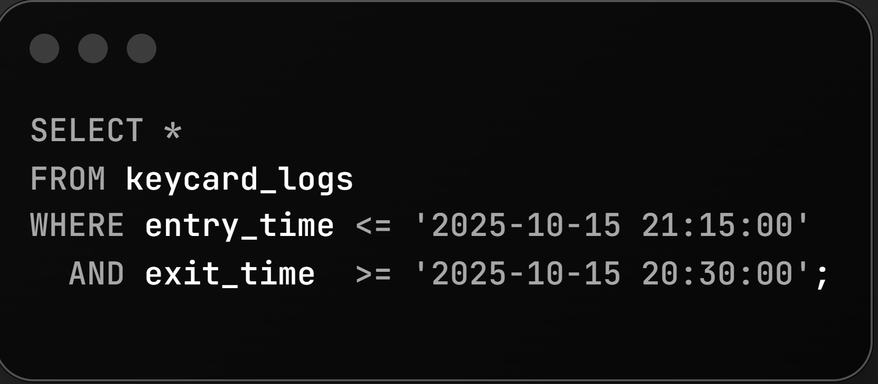

Step 1: Who Was in the CEO Office?
SQL checks 20:30–21:15.
Output:
👉 Only David Kumar was inside the CEO Office from 20:50 to 21:00.
Insight: Only one person has access at the crime moment = David becomes the prime suspect.

Slide 4
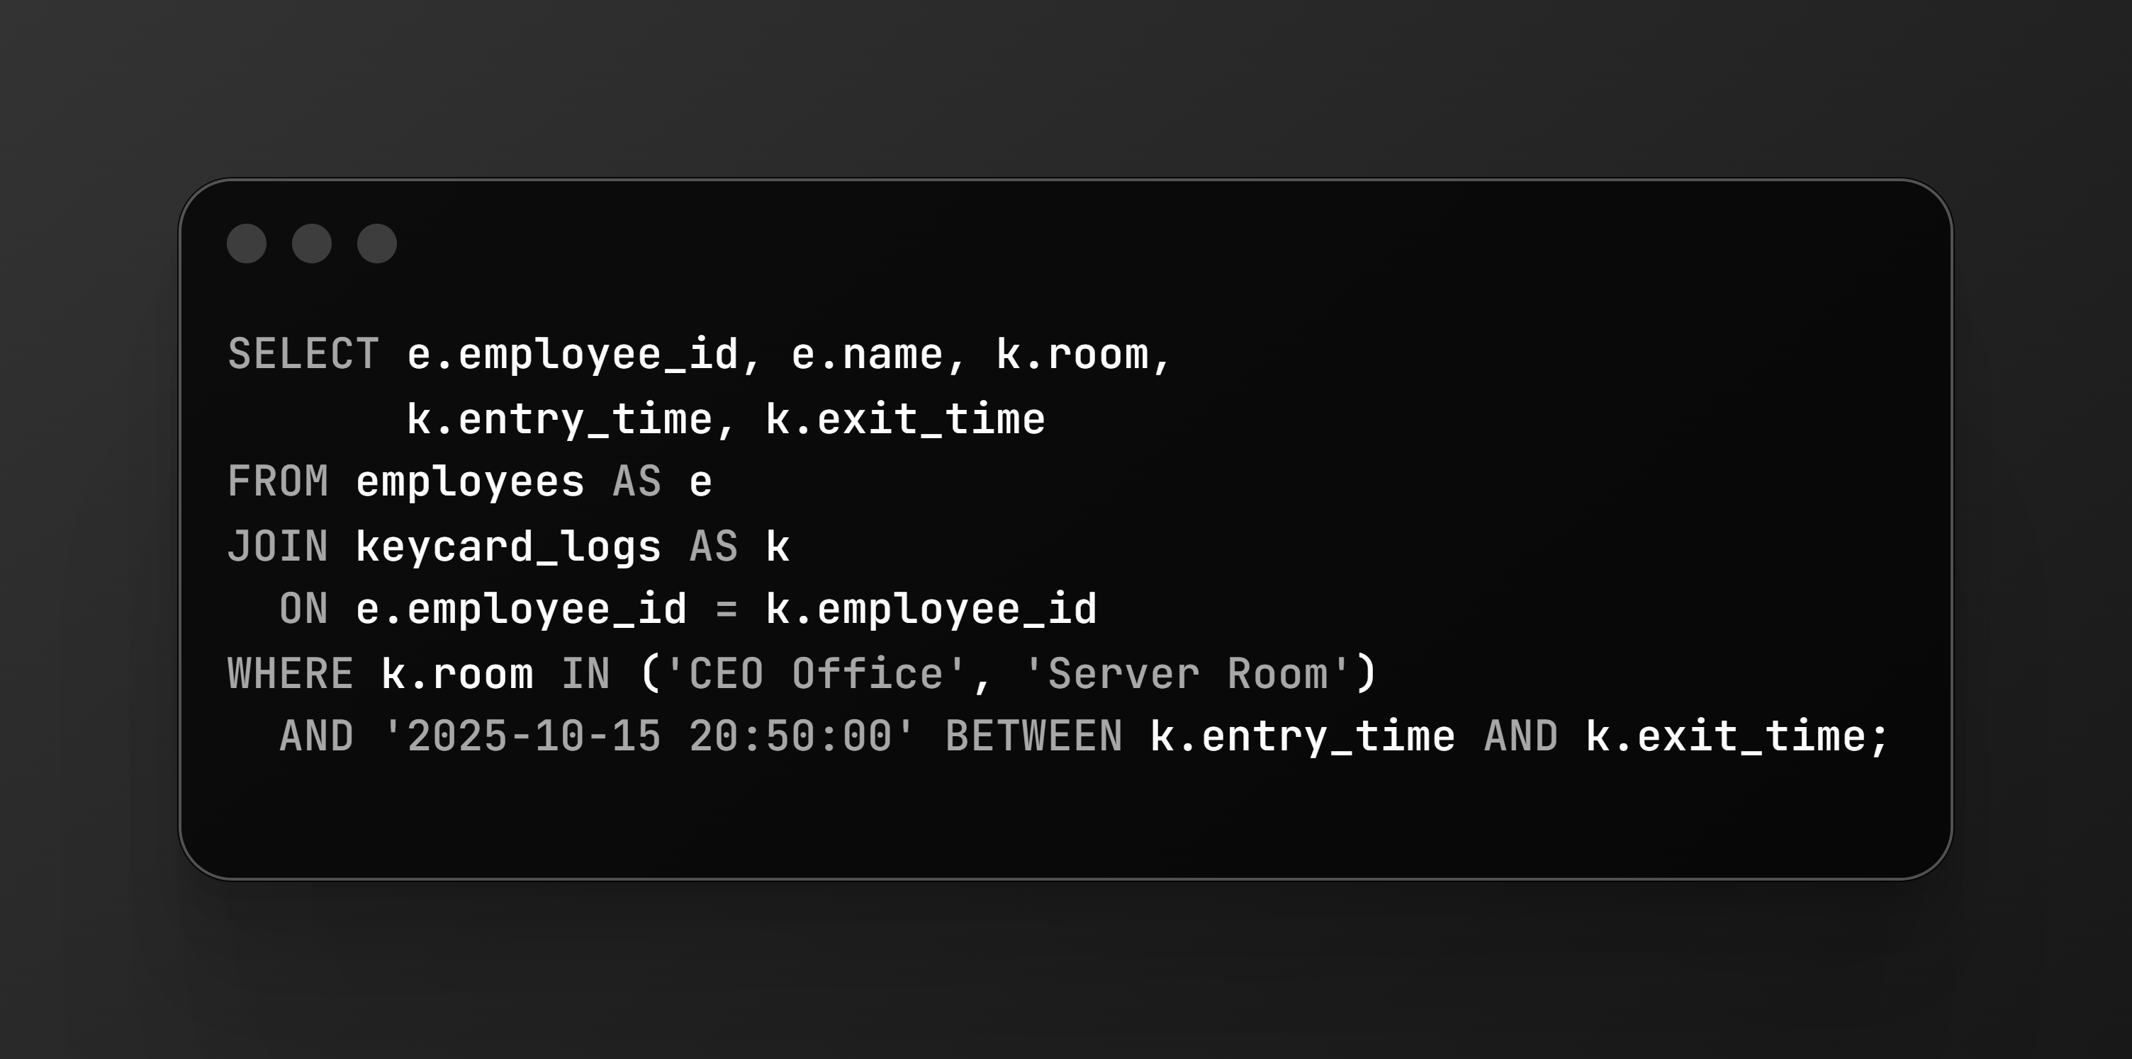
Step 2: Who Was in Critical Rooms?
Critical rooms:
CEO Office
Server Room
Exact time checked: 20:50
Output:
👉 Again, only David Kumar is inside a critical room - and that too, the CEO Office.
Insight: No one else could have committed the crime during this minute.

Slide 5

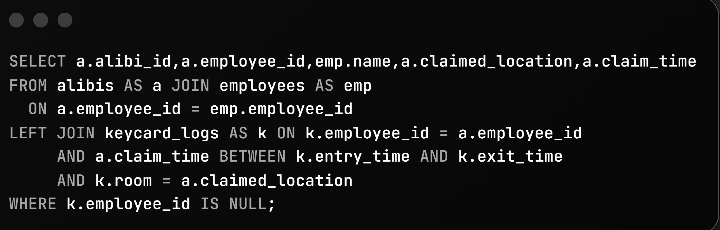
Step 3: Whose Alibi Fails?
We matched claimed location vs actual keycard data.
Output:
👉 4 employees lied. But David Kumar claimed he was in the Server Room
Actual: He was NOT there. He was in the CEO Office at that exact time.
Insight: David's alibi is provably false.

Slide 6
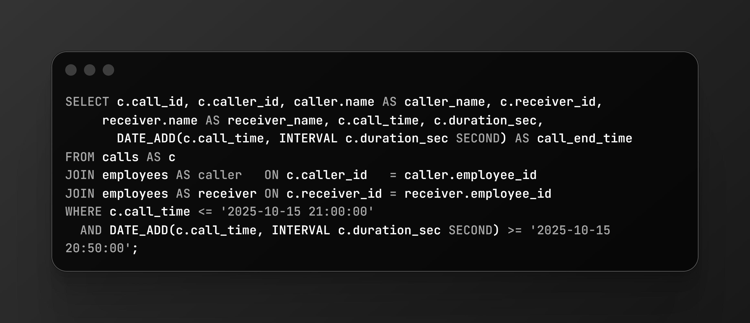
Step 4: Suspicious Call Activity
We checked calls overlapping 20:50–21:00.
Result:
📞 One call found
David Kumar ↔ Alice Johnson
Time: 20:55–20:55:45
Insight: David was awake, active, and using his phone inside the CEO Office at the crime time.

Slide 7

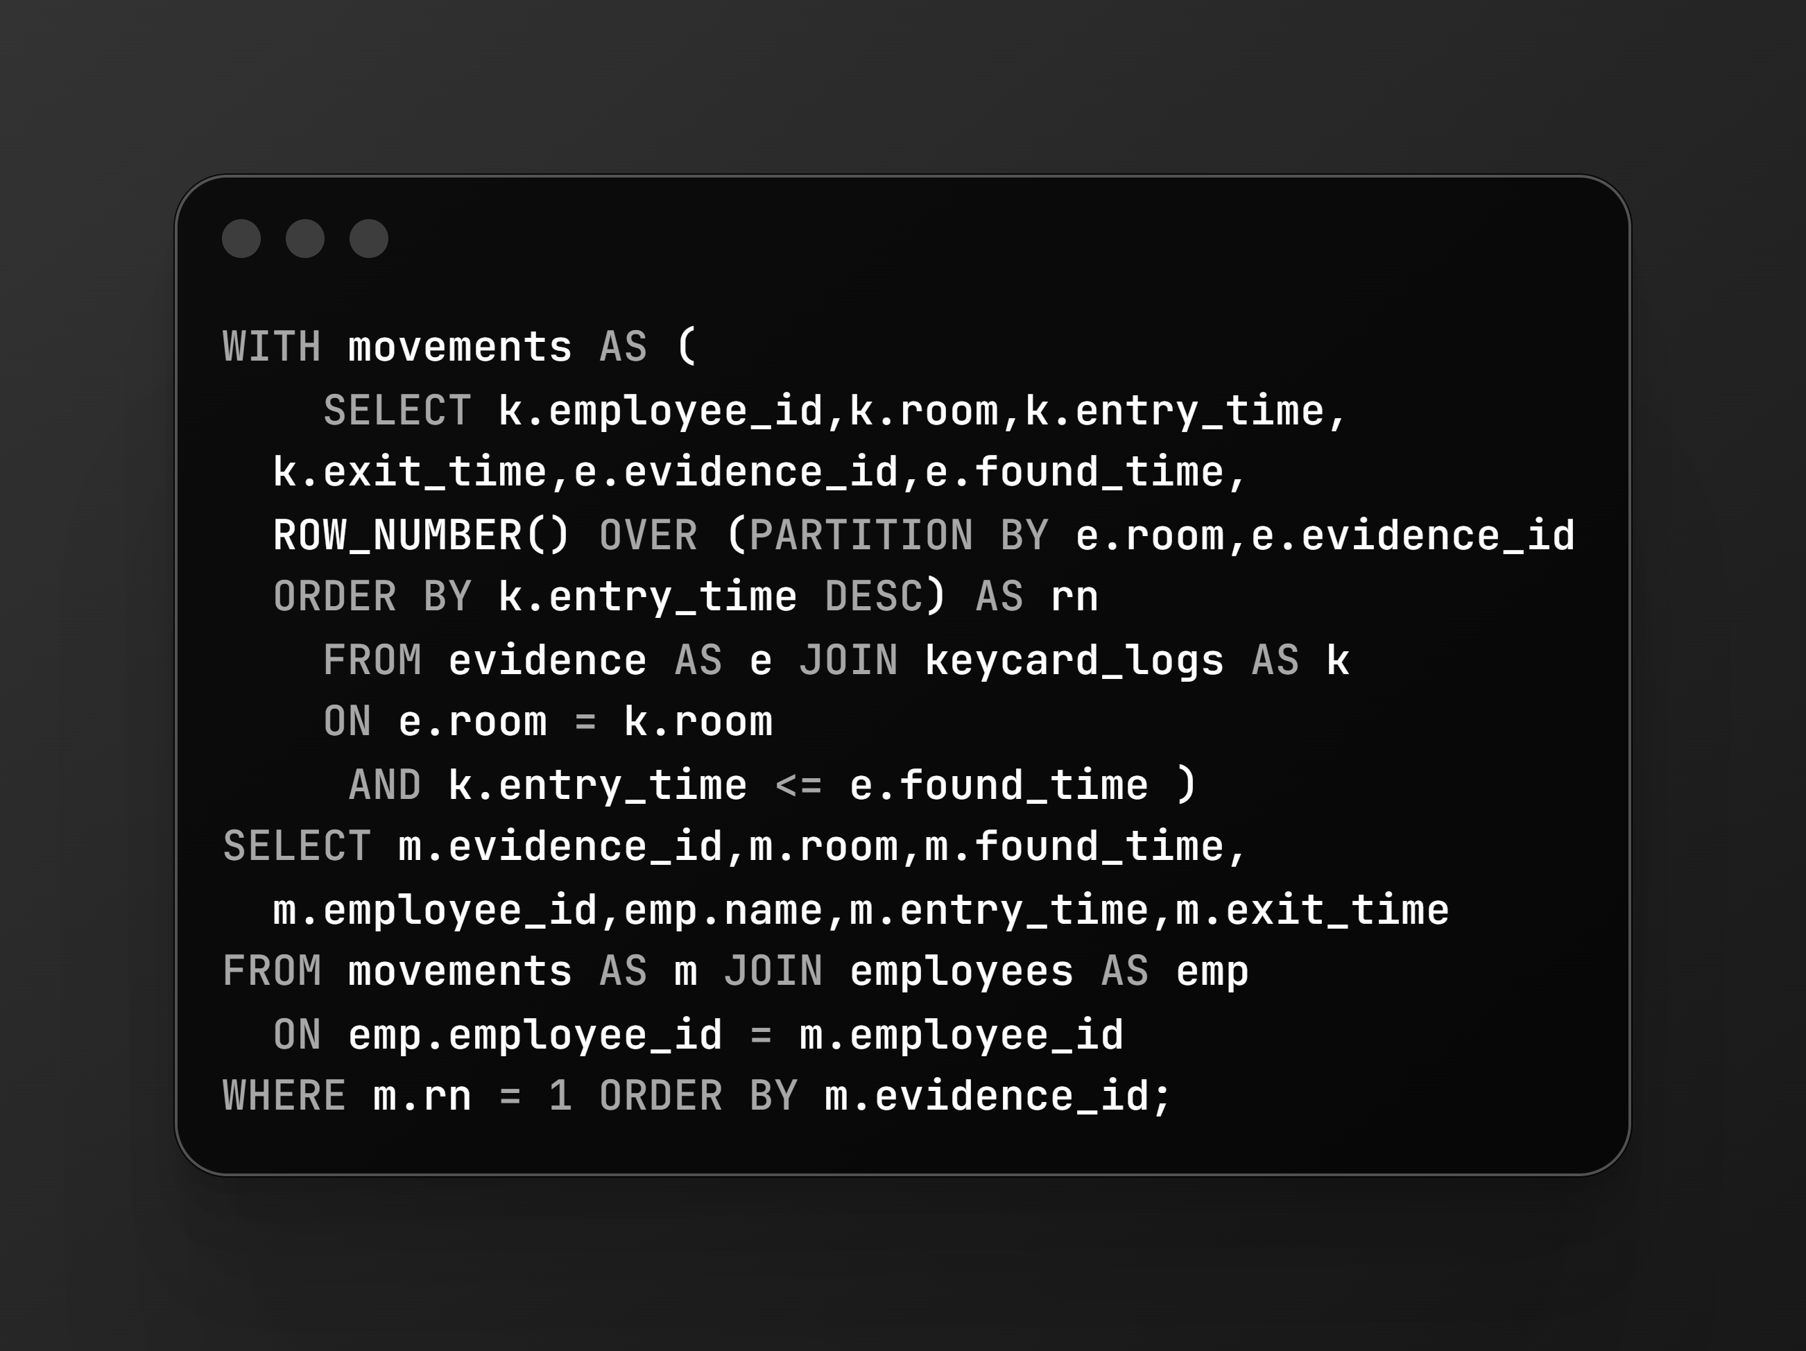

Step 5: Evidence Matching
We checked who was last in each room before evidence was found.
Evidence 1 → CEO Office → Last seen: David Kumar
Evidence 2 → CEO Office → Last seen: David Kumar
Evidence 3 → Server Room → Last seen: David Kumar
Insight: All evidence trails point back to him.

Slide 8
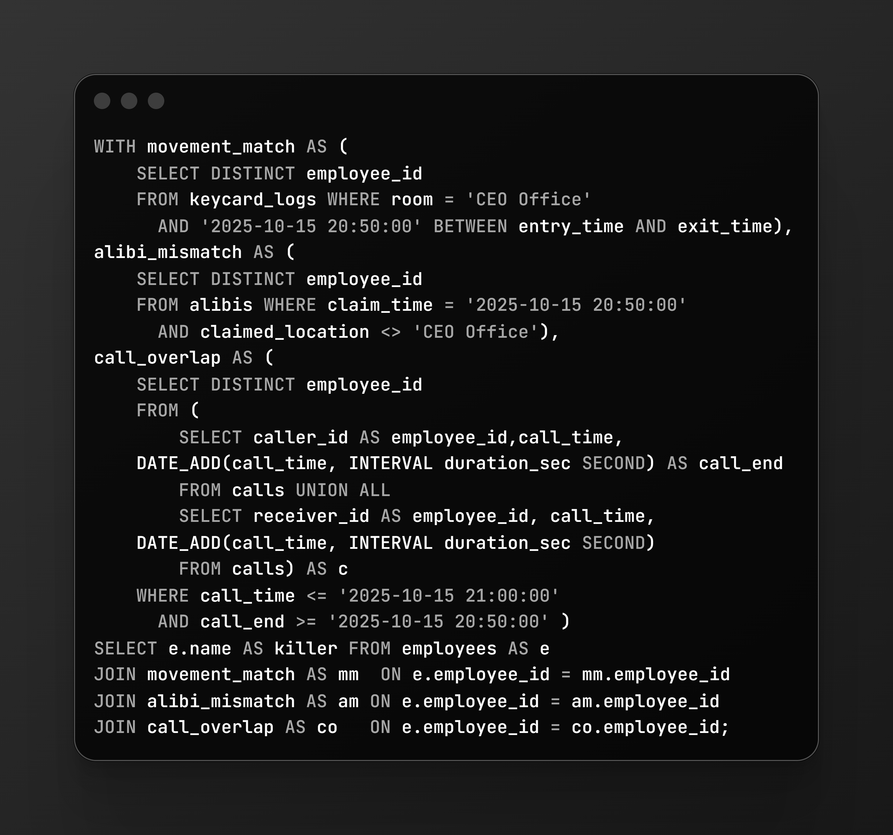
Step 6: Final Cross-Check
We combined three conditions:
In CEO Office at 20:50
David ✔️
Fake alibi
David ✔️
Call at crime time
David ✔️
Total people meeting ALL 3 conditions: 👉 Only David Kumar
Final Killer Reveal
Name: David Kumar
🟥 Accessed the crime scene
🟥 Lied about his location
🟥 All evidence matched him
🟥 Calling someone at the time

Slide 9





Case Summary (Short & Simple)
David was in the CEO Office at crime time
Lied about being in the Server Room
Made a suspicious call
All physical evidence points to him
Intersection of all SQL checks = David Kumar
📌 Conclusion: 👉 David Kumar is the murderer.

Slide 10
Thank You
SQL + Detective Skills = Case Closed
🔍 By: Sonali Gupta
📊 SQL | Data Analyst | Problem Solver

